Slide 1
Machine Learning and China economy: Machine Learning Model to analysis economy and predict retail sale of China 机器学习与中国经济：经济数据分析和机器学习模型预测中国零售数据
Liu JinKua
jinkual@kean.edu
Advisor: Chun Te Lee

Slide 2
Outline
Introduction
Dataset description
Methodology
Pre-COVID-19 Data Analysis
Implementation of Machine Learning Model
Conclusion
Reference

Slide 3
Introduction
China is developing rapidly
Impact of COVID-19
Wholesale and Retail Trade (WRT) an part of China economy

Slide 4
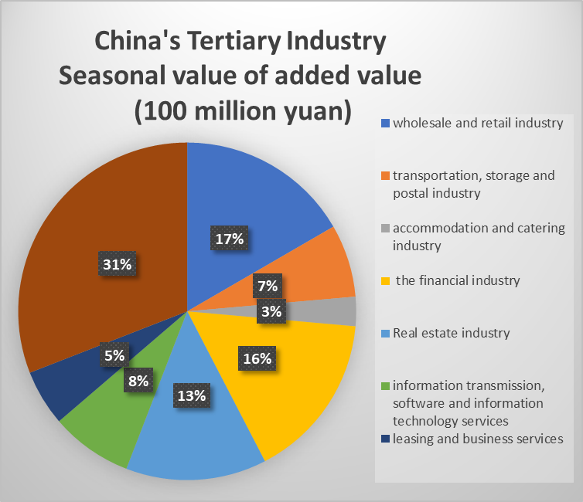
Introduction
Figure 1: China’s Tertiary Industry Seasonal value of add value
(Other industry in tertiary industry, 31%)

Slide 5
Introduction
China is developing rapidly
Impact of COVID-19
As a important part of China economy
What future will be for the China’s Wholesale and Retail trade

Slide 6
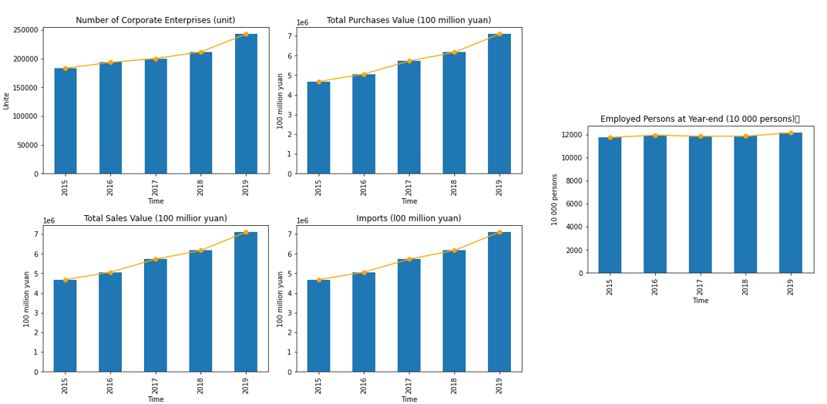
Introduction
Figure 2: The general tendency of China WRT

Slide 7
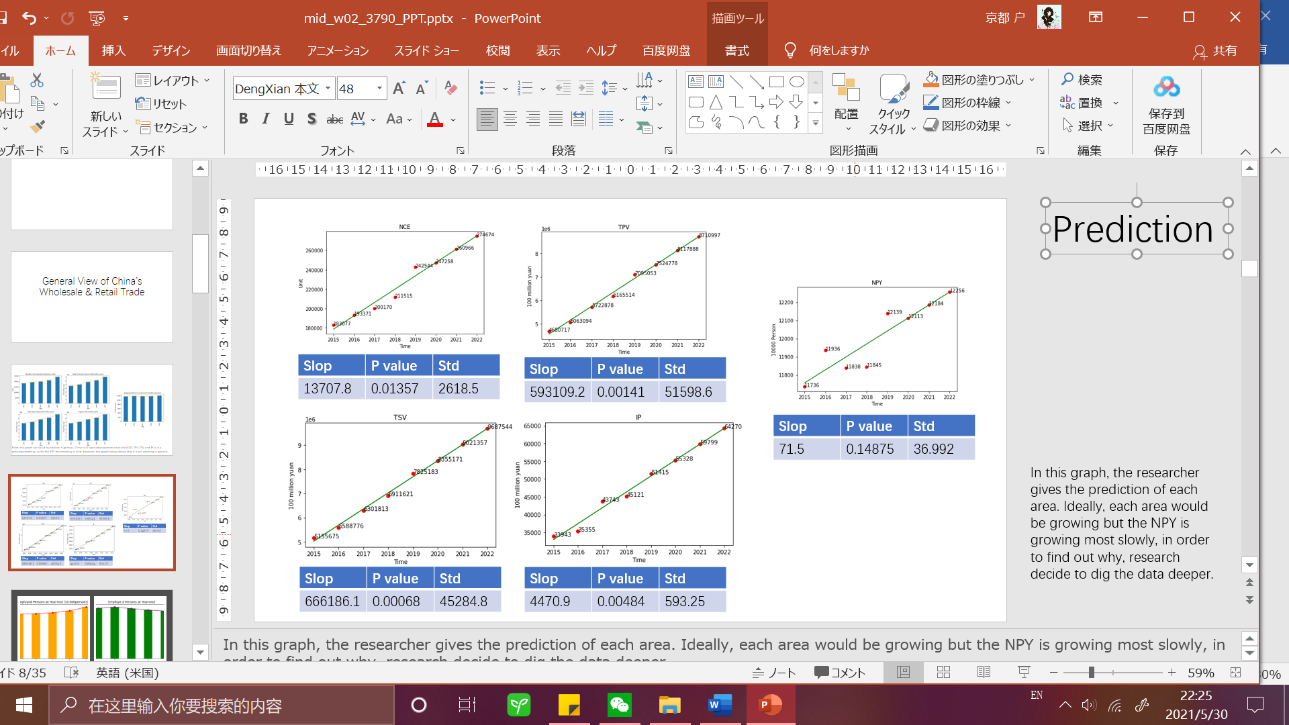
Introduction
Figure 3: The linear regression of China WRT

Slide 8
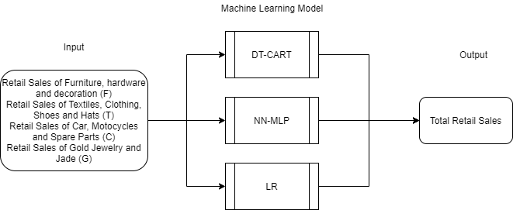
Introduction
Model of prediction by CART-DT, NN-MLP and Linear Regression
Figure 4: The Machine Learning Model

Slide 9
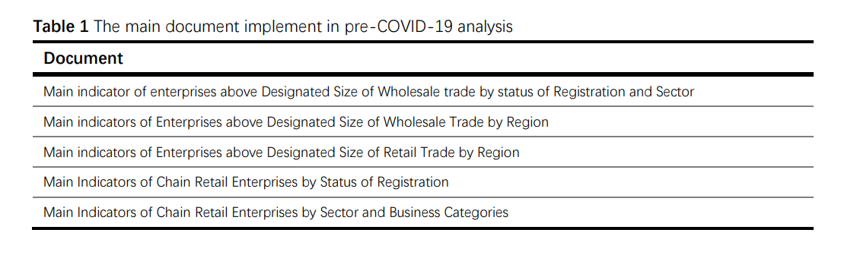
Dataset Description
China statistic yearbook 2020 from 2015 to 2019
National Bureau of statistics from 12/2019 to 4/2021

Slide 10
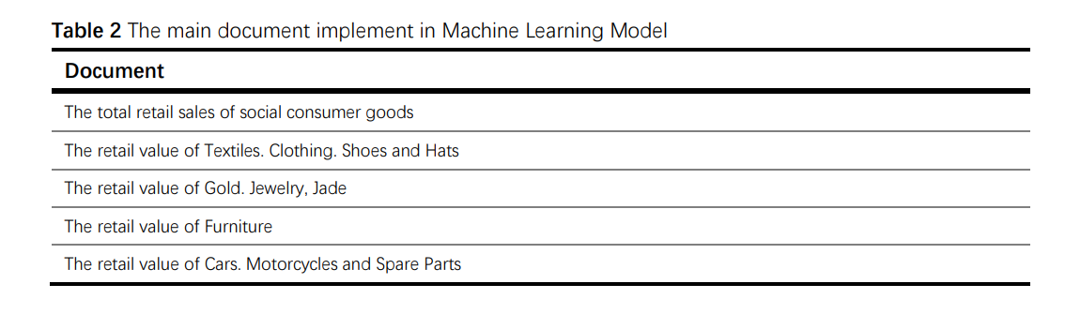
Dataset Description
China statistic yearbook 2020 from 2015 to 2019
National Bureau of statistics from 12/2019 to 4/2021

Slide 11
Methodology
Two part in this research
Pre-COVID-19 data analysis
Machine Learning Implementation

Slide 12
Methodology Pre-COVID-19 data analysis
Data Visualization of China’s Wholesale and Retail Trade
Linear Regression and Data Cluster by K means
To study the background of China’s economy

Slide 13
Methodology Machine Learning Implementation
Figure 5: The Machine Learning Model

Slide 14
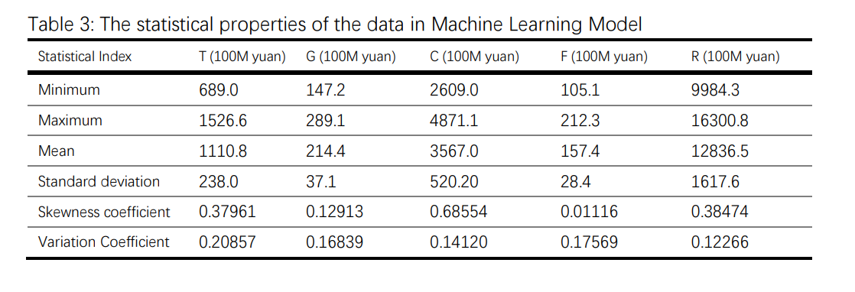
Methodology Machine Learning Implementation
Data: 4/2021-12/2019
21 Months with 2 invalid

Slide 15
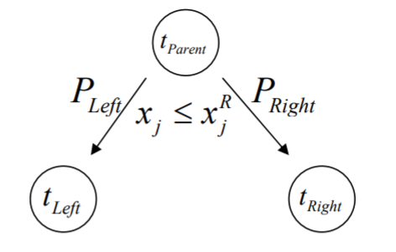
Methodology Machine Learning Implementation
Classification and Regression Tree (CART)
$$argmin \left[P_{t}Var\left(Y_{l}\right)+P_{r}Var\left(Y_{r}\right)\right] \left(x_{j} , <x_{j}^{R} j=1…M\right)$$
Figure 6: The CART decision tree

Slide 16
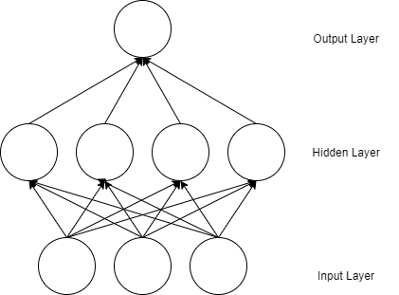
Methodology Machine Learning Implementation
Multilayer Perceptron Neural Network (MLP NN)
Figure 8: The NN-MLP

Slide 17
Implementation
Data processing
Prediction Model implementation
Models Evaluation

Slide 18
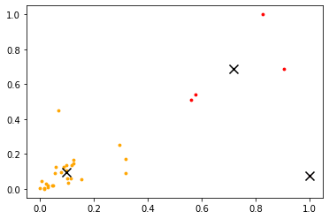
Pre-COVID-19 Data Analysis
Figure 9: The cluster of each province by total profit and total asset in Wholesale data

Slide 19
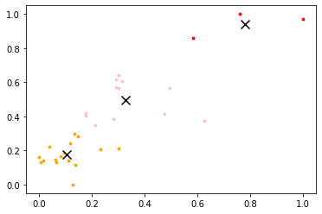
Pre-COVID-19 Data Analysis
Figure 10: The cluster of each province by total profit and total asset in retail data

Slide 20
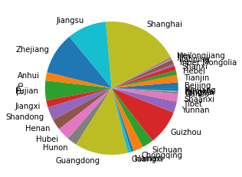
Pre-COVID-19 Data Analysis
Figure 11: The distribution of total profit of each province in Wholesale data

Slide 21
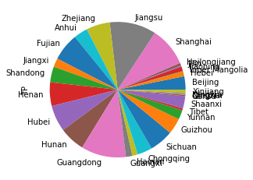
Pre-COVID-19 Data Analysis
Figure 12: The distribution of total profit of each province in retail data

Slide 22
Pre-COVID-19 Data Analysis
Data Visualization of China’s Wholesale and Retail Trade
Linear Regression and Data Cluster by K means
To study the background of China’s economy

Slide 23
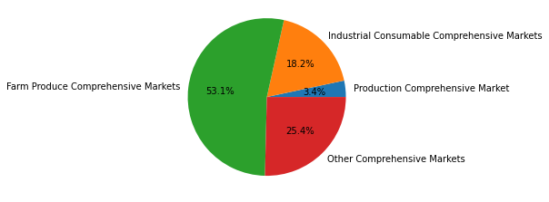
Implementation of MLM Data processing
Figure 13: The general view of General Market in WRT by number of markets

Slide 24
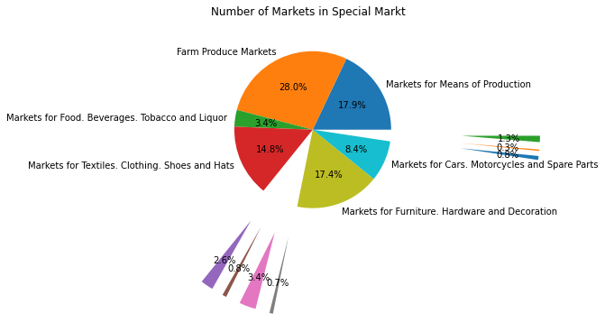
Implementation of MLM Data processing
Figure 15: The general view of Special Market in WRT by number of markets

Slide 25


Implementation of MLM Data processing
Per Booths average profit(PBP)
Per market average profit (PMP)
$$PMP=\frac{Turnover(100M yuan)}{NumBooth (Unit)}$$
$$PBP=\frac{Turnover(100M yuan)}{NumMarket (Unit)}$$

Slide 26
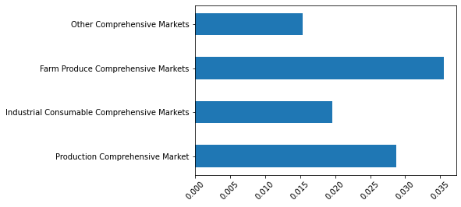
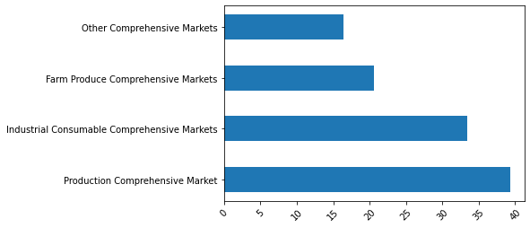
Implementation of MLM Data processing
Figure 16&17: PBP(left) & PMP(right) of General Market

Slide 27
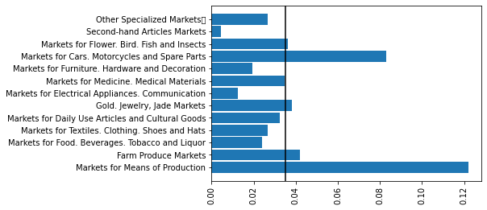
Implementation of MLM Data processing
Figure 18: PBP of Special Market

Slide 28
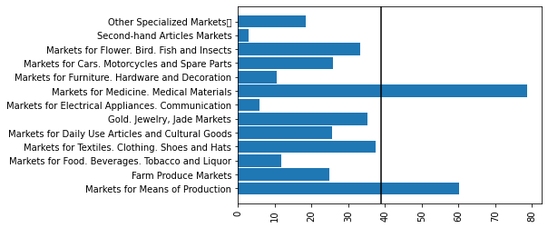
Implementation of MLM Data processing
Figure 19: PMP of Special Market

Slide 29
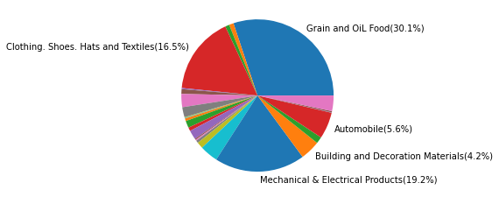
Implementation of MLM Data processing
Figure 20: Commodity Exchange Market with 100M trade Turnover

Slide 30
Implementation of MLM Data processing
Special Market
For PBP
Markets for Cars Motorcycles and Spare Parts
Gold Jewelry, Jade Markets
For Exchange Market with 100M trade Turnover
Markets for Furniture
Markets for Textiles Clothing. Shoes and Hats
Due to the sparse data some of the highest profit market is exclude

Slide 31
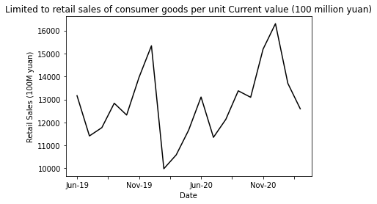
Implementation of MLM Data processing
Goal: To find the highest correlation market with the Retail Sales in time series
Analysis through time correlation
Figure 21: The plot diagram of Retail sale in time series

Slide 32
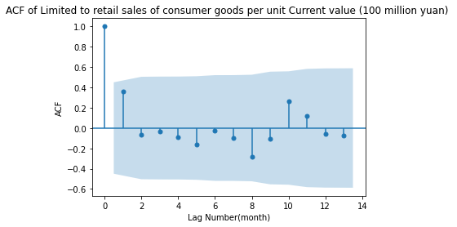
Implementation of MLM Data processing
Goal: To find the highest correlation market with the Retail Sales in time series
Analysis through time correlation by using ACF & CCF
Figure 22: ACF diagram of Retail sale

Slide 33
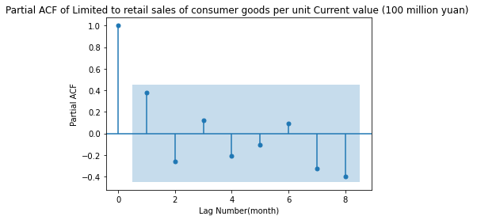
Implementation of MLM Data processing
Goal: To find the highest correlation market with the Retail Sales in time series
Analysis through time correlation
Figure 23: PACF diagram of Retail sale

Slide 34
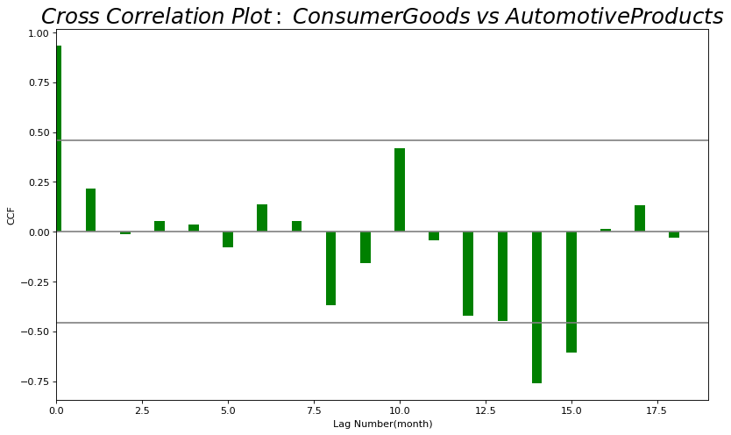
Implementation of MLM Data processing
Goal: To find the highest correlation market with the Retail Sales in time series
Analysis through time correlation
Figure 22: CCF diagram of Retail sale and Car
Notes:
Goal find

Slide 35
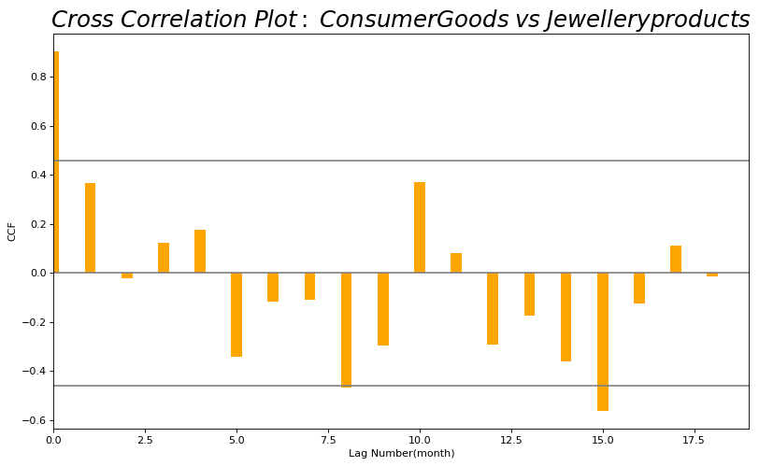
Implementation of MLM Data processing
Goal: To find the highest correlation market with the Retail Sales in time series
Analysis through time correlation
Figure 23: CCF diagram of Retail sale and Gold, Jewel and Jade

Slide 36
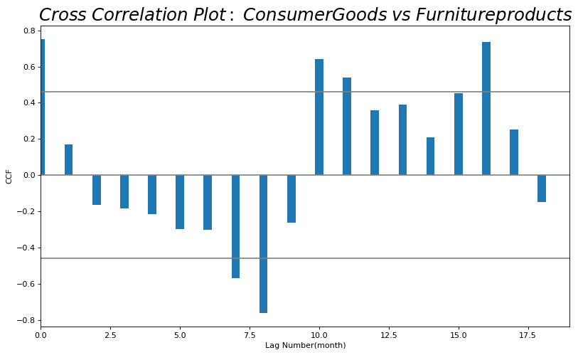
Implementation of MLM Data processing
Goal: To find the highest correlation market with the Retail Sales in time series
Analysis through time correlation
Figure 24: CCF diagram of Retail sale and Furniture

Slide 37
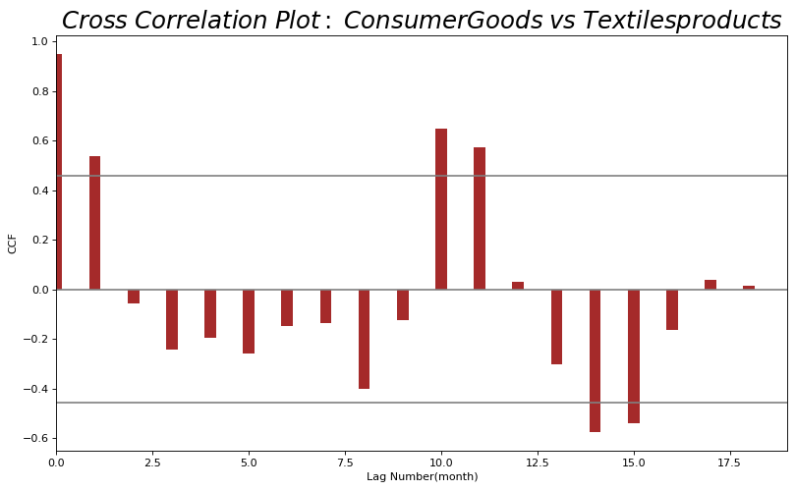
Implementation of MLM Data processing
Goal: To find the highest correlation market with the Retail Sales in time series
Analysis through time correlation
Figure 25: CCF diagram of Retail sale and Textiles, Clothe

Slide 38
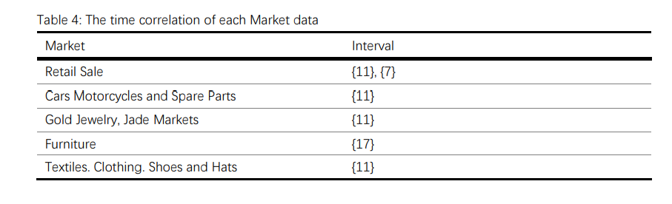
Implementation of MLM Data processing
Notes:
加入解释行

Slide 39
Implementation of MLM Data processing
Retail Sale {11}
Cars Motorcycles and Spare Parts {11}
Gold Jewelry, Jade Markets {11}
Textiles. Clothing. Shoes and Hats {11}

Slide 40
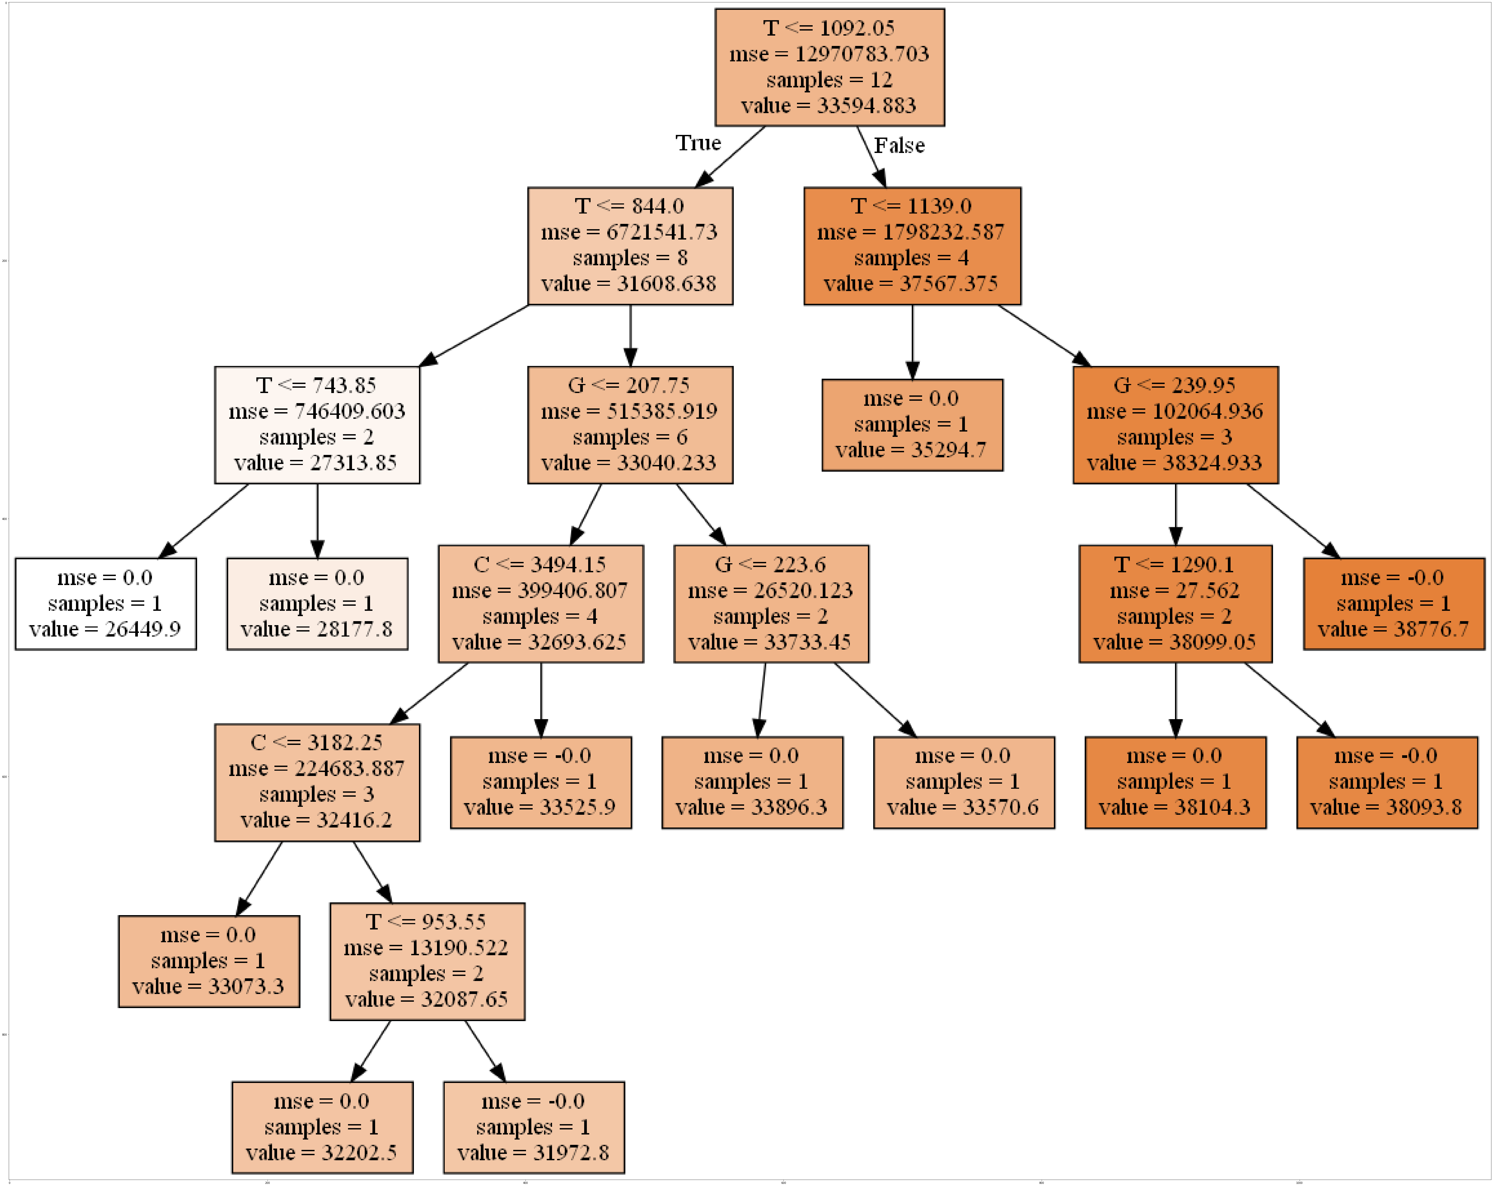
Implementation of MLM
Classification and Regression Tree (CART)
Figure 26: DT-CART diagram generate in this research

Slide 41
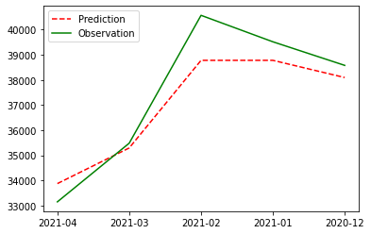
Implementation of MLM
Figure 27: Diagram of WRT retail sale prediction for CART

Slide 42
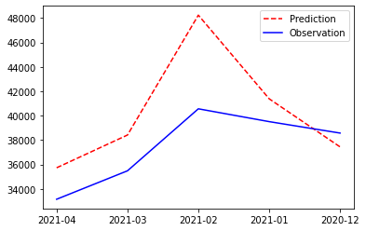
Implementation of MLM
Figure 28: Diagram of WRT retail sale prediction for NN MLP
Notes:
legends

Slide 43
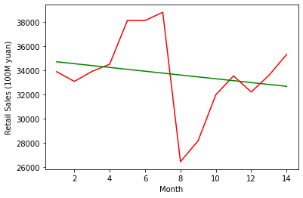
Implementation of MLM
Figure 29: Diagram of WRT retail sale training for LR
Green line is the formula of the prediction
Red line is the observation data
Notes:
legends

Slide 44
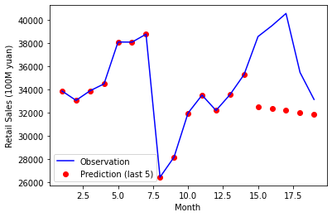
Implementation of MLM
Figure 30: Diagram of WRT retail sale prediction for LR
Notes:
legends

Slide 45
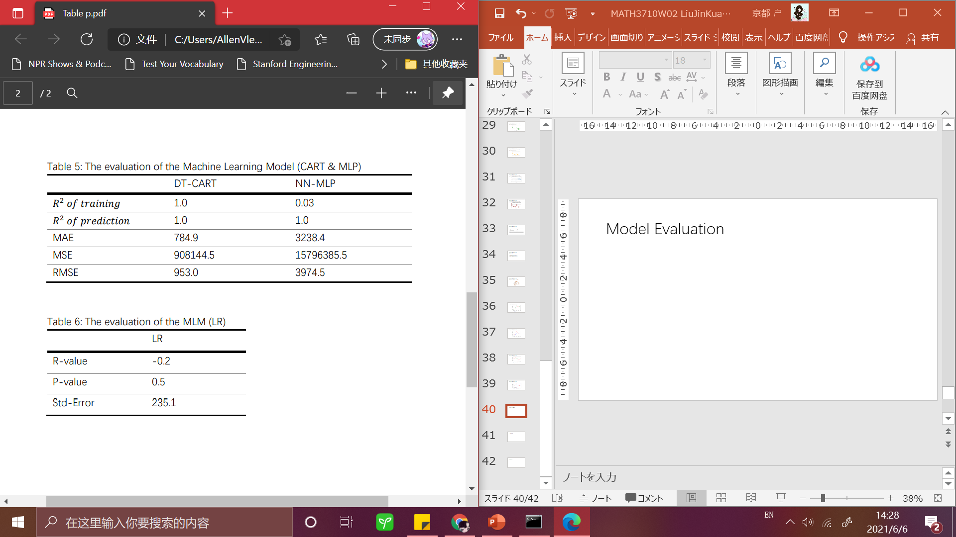
Model Evaluation

Slide 46
Model Evaluation

Slide 47
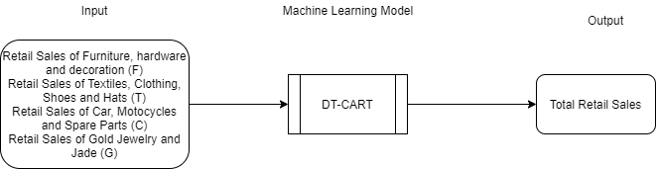
Conclusion
CART Decision Tree: the most suitable model
LR: the least suitable model
NN-MLP need more data to get accurate result
Figure 31: The ultimate machine learning model for prediction of China’s retail sale

Slide 48
Reference
Onder, O., Karagol, E. T., & Ozbugday, F. C. (2021). Machine learning approach to drivers of bank lending: Evidence from an emerging economy. Financial Innovation, 7(1) doi:http://dx.doi.org.kean.idm.oclc.org/10.1186/s40854-021-00237-1
Spotle.ai. (12/9/2019). Classification and Regression Tree (CART) with Python. Retrieve from: Spotle.ai: https://spotle.ai/feeddetails/Classification-and-Regression-Tree-CART-with-Python/3644
Zounemat-Kermani Mohammad, Ramezani-Charmahineh Abdollah, Reza, R., Meysam, A., & Ouarda Taha, B. M. J. (2020). Machine learning and water economy: A new approach to predicting dams water sales revenue. Water Resources Management, 34(6), 1893-1911. doi:http://dx.doi.org.kean.idm.oclc.org/10.1007/s11269-020-02529-0

